Slide 1






FTTell
Diagnosis failure to thrive among children
Capstone Project Phase B -24-1-D-3
Sabeel Hamood : 211581343
Ehsan Sarboukh : 209002534
Supervisor:
Dr. Natali Levi-Soskin
Notes:
אחסאן

Slide 2

What is Failure To Thrive?
FTT (Failure to Thrive) is a medical term used to describe inadequate weight gain or inadequate weight loss in children or infants, indicating inadequate growth and development.
FTT can be diagnose among all different ages of children.
1
Notes:
אחסאן

Slide 3



The Problem
The FTT diagnosis process is lengthy and may lead to various medical complications for the patient due to delayed identification and treatment.
Despite standardized quantitative definitions, FTT can be overlooked or misdiagnosed.
Non-organic FTT is often diagnosed without quantitative data, as pediatricians must observe the child's behavior, which makes the task impossible.
2
Notes:
אחסאן

Slide 4
Existing Solutions
Most used methods
Growth Monitoring.
Medical History and Physical Examination.
Nutritional Assessment.
Psychosocial Evaluation.
Rourke Baby Record (RBR)
Developed in Canada is a comprehensive tool for growth monitoring but is not used for diagnosing FTT.
3
Notes:
אחסאן

Slide 5


System Requirements
4
Notes:
סביל

Slide 6
Functional Requirements
The system allows the users to insert new data.
The system stores data in a database.
The system shows the analysis of the result in real time.
The system offers pediatricians registration for the system.
The system can be used from any location with Wi-Fi access.
The system allows pediatricians the usage of the camera for diagnosing (Computer Vision).
The systems offers a guidance tutorial.
The system gives permission to authorized users to login (Pediatrics).
The system offers to pediatricians a suitable nutrition plan for each patient.
5
Notes:
סביל

Slide 7
Non-Functional Requirements
user friendly interface.
Simple interaction mechanism.
Real time analysis.
The data is secured really well
Application works 24/7
6
Notes:
סביל

Slide 8

Our Solution
7
Notes:
סביל

Slide 9
FTTell
FTTell is a modern diagnostic system for children suffering from Failure to Thrive (FTT), combining user-friendly growth assessment tools with advanced pediatrician features. It uses validated formulas, computer vision, and AI-generated nutritional plans for early detection and professional evaluation.
8
Notes:
סביל

Slide 10



Frontend Technologies
9
Notes:
אחסאן

Slide 11


Backend Technologies
Express js
10
Notes:
אחסאן

Slide 12

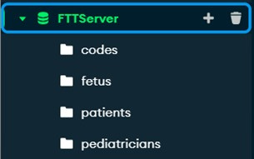

Database
11
Notes:
אחסאן

Slide 13

AI-Tool ChatGPT
const chatPromptBreakfast =`The result is: ${resultText}. Write me a nutrition plan for breakfast for this child considering the allergic and the symptoms with bullet points-without including any introductory or repetitive statements, add in the plan food that suitable to the child age and allergies.`;
const chatPromptLunch = `The result is: ${resultText}. Write me a nutrition plan for lunch for this child considering the allergic and the symptoms with bullet points-without including any introductory or repetitive statements, add in the plan food that suitable to the child age and allergies.`;
const chatPromptDinner = `The result is: ${resultText}. Write me a nutrition plan for dinner for this child considering the allergic and the symptoms with bullet points-without including any introductory or repetitive statements, add in the plan food that suitable to the child age and allergies.`;
12
Notes:
אחסאן

Slide 14


Computer Vision
FER
13
Notes:
אחסאן

Slide 15
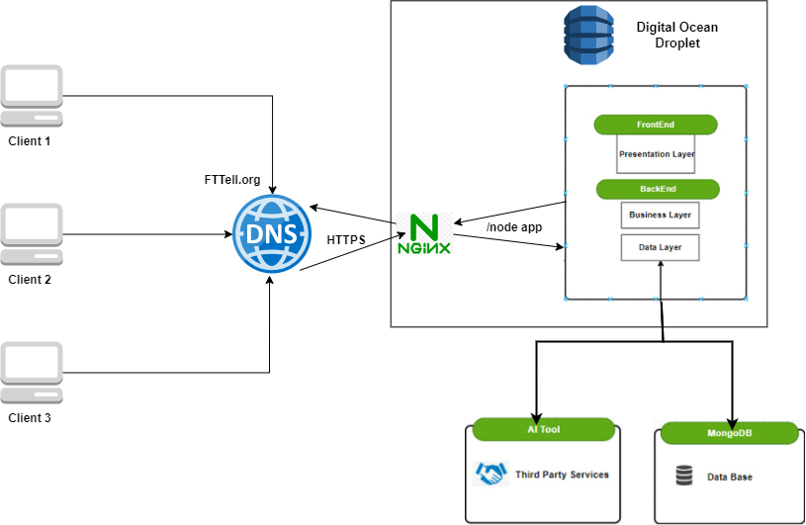
3-Tier Architecture
14
Notes:
אחסאן

Slide 16
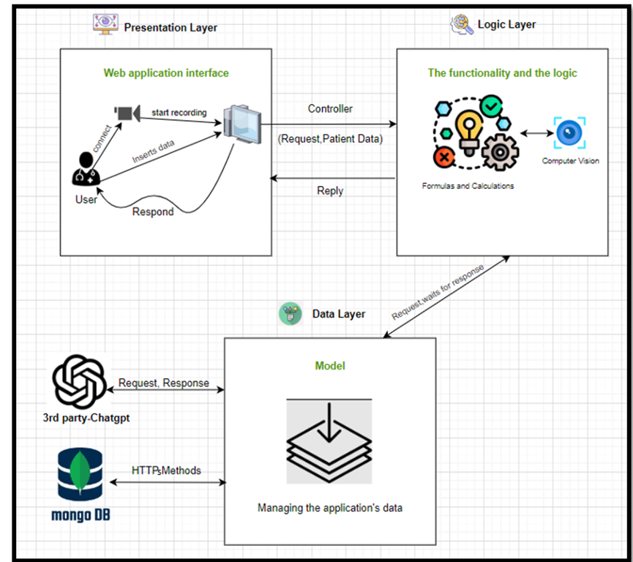
MVC - Architecture
15
Notes:
סביל

Slide 17
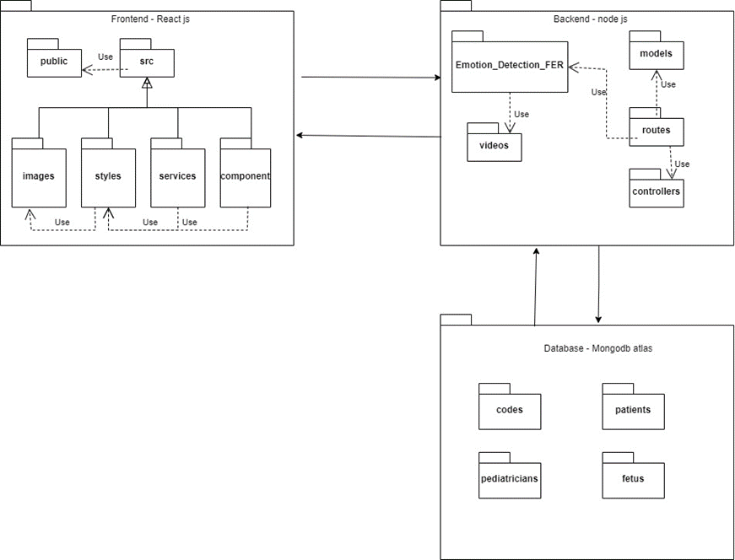
Package Diagram
16
Notes:
סביל

Slide 18
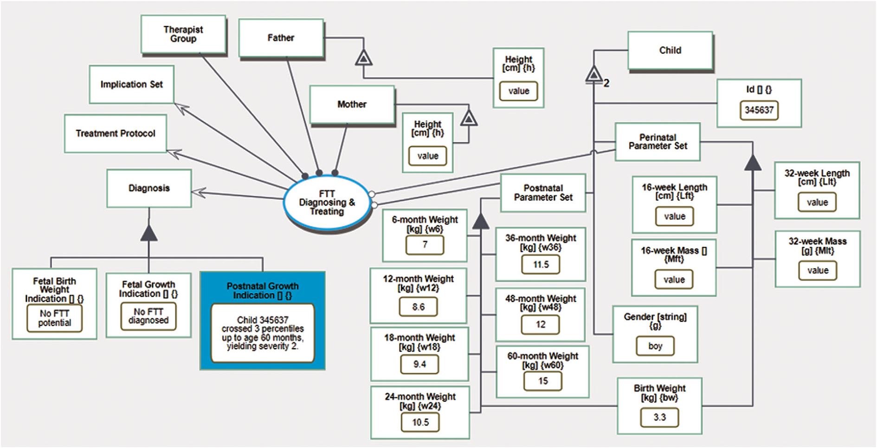
OPM
17
Levi‐Soskin, N., Yasin, F., Dori, D., & Shaoul, R. (2023). Model‐based diagnosis with FTTell: Diagnosing early pediatric failure to thrive. Systems Engineering.
Notes:
סביל

Slide 19

Testing Procedure
User Experimentation and Testing Methodology.
Testing Formulas and Diagnostic Accuracy for Non-Pediatrician Users.
Testing the diagnosis process for pediatrician.
Networking and API testing with Postman.
18
Notes:
אחסאן

Slide 20
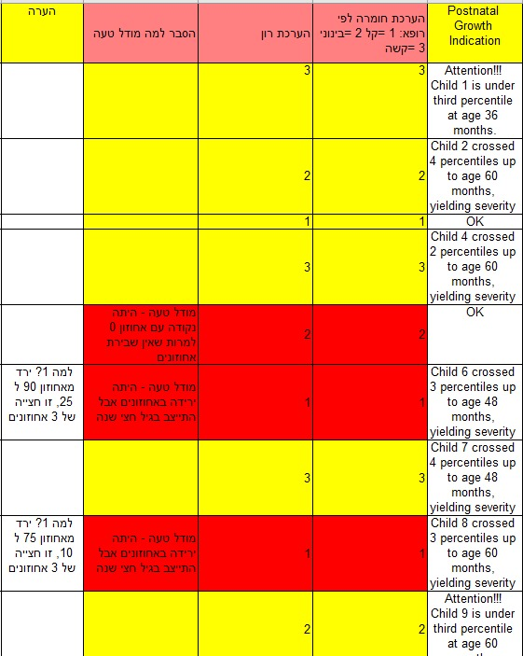
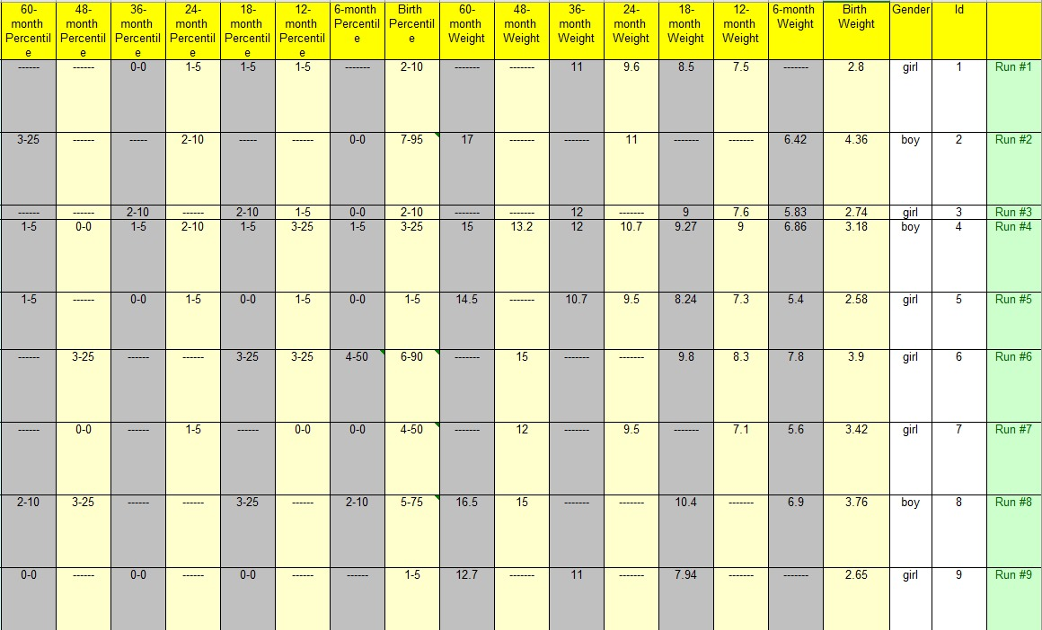
FTTell Test Results for 100 Children
19
Notes:
סביל

Slide 21

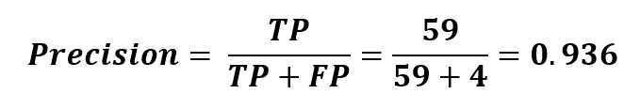
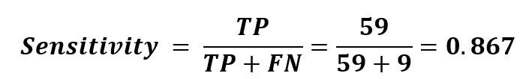
Performance Metrics
20
Notes:
סביל

Slide 22
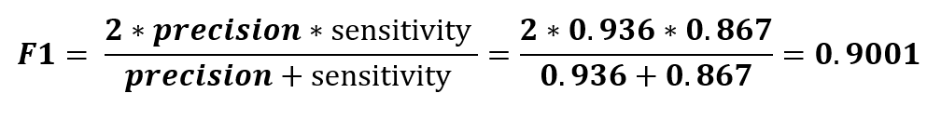
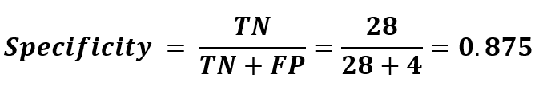
Performance Metrics
F 1 score – the harmonic mean (average) of the precision and sensitivity
Specificity- the ratio between the number of infants that were correctly labeled by
FTTell as not having FTT and all the infants that actually did not have FTT.
21
Notes:
סביל

Slide 23




Challenges and Constraints
Restrict access
securing sensitive data
Using computer vision
22
Notes:
סביל

Slide 24
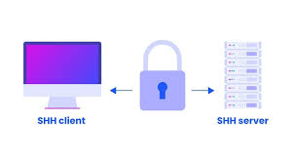

Challenges and Constraints
Secure Client-Server Communication
Accuracy in AI result
Deployment
23
Notes:
סביל

Slide 25




Project Success Metrics
User Friendly
Estimated Accuracy
90% +
Early diagnoses
Scalability
24
Notes:
אחסאן

Slide 26
Simulation
https://www.fttell.org/
25
Notes:
אחסאן

Slide 27
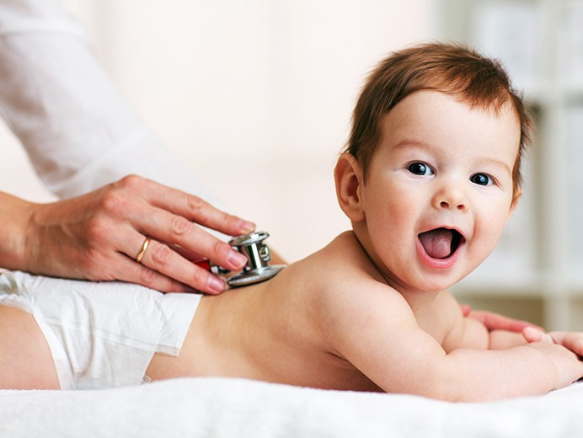
Thank
You.
For Your Attention

